Slide 1
Marketing Campaigns Optimization: Regression and Correlation Analysis
By Parkhat Bazakov
Last updated: 2/25/2023

Slide 2
Objective
Determining the effectiveness of the marketing tactics by exploring correlation

Slide 3
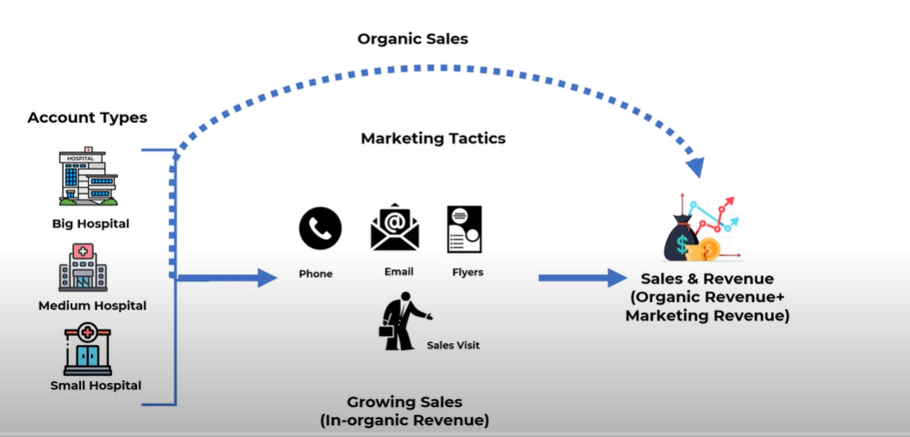

Slide 4
Data source
Secondary data taken from
https://absentdata.com/
Steps taken
Stochastic analysis of correlation
Regression analysis using Python
Large P-value results have been filtered out due to irrelevance

Slide 5
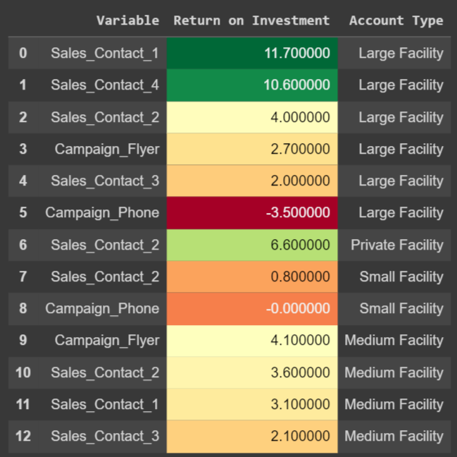
Results
ROI (Return on Investment ) in relationship to Marketing type and Account type

Slide 6
Conclusion
Sales Visits (Sales contact) has shown the highest ROI, therefore investing in these areas would benefit an overall campaign.
These visits might be more significant due to position in the sales cycle.
However, flyers were also significant in accounts collected.
Synergy between these tactics may need exploration.

